Slide 1
Stream Processing Live Traffic Data with Kafka Streams

Slide 2
Brought to you by

Slide 3


Who are we
Jasper Rosiers
Java Developer @ Ordina
Tom Van den Bulck
Principal Java Software Engineer @ Ordina
@tomvdbulck

Slide 4

Setup Environment
https://github.com/Stream-Processing-with-Kafka-Streams/devoxxpl
Notes:
Shorter feedback loop: fraud detection, much nicer feedback to the customers, …

Slide 5
What
https://github.com/Stream-Processing-with-Kafka-Streams/devoxxpl
Notes:
The old days:
Query in order to retrieve data you need
The glorious time of the batch jobs

Slide 6
What
https://github.com/Stream-Processing-with-Kafka-Streams/devoxxpl
Notes:
Reacts on Events
Events should be as complete as possible
Continuous stream

Slide 7
What: Event
Data it owns
Data it needs
References data
Notes:
Data it owns: this is data tied owned by the publisher in the event
Data it needs: this is data which can originate from other services but which is necessary to handle the event
Referenced Data: data which might be relevant for the event. For example when booking a holiday, the reference temperatures of the location to where you want to travel to. Example contract update: owns: new price / needs: contract data, old price, discounts, …. / references: customer data to contact customer

Slide 8
What: Streaming
Reacts on events
Continuously
Notes:
Shorter feedback loop: fraud detection, much nicer feedback to the customers, …

Slide 9
Why
Much shorter feedback loop
More resource efficient
Stream processing feels more natural
Decentralize and decouple infrastructure
Notes:
Much shorter feedback for your business users
Because you are processing smaller sets of data at the same time resources can be used more efficiently
Stream processing tends to feel more natural, as most data also enters your system as a stream
There is no longer a need for large and expensive databases, each stream processing application maintains its own data and state And each application also tends to decide itself what it will consume

Slide 10
The Data

Slide 11
The Data
Every minute XML is generated
So it is not the raw data
Be aware:
Dutch words

Slide 12
The Data
XML with fixed sensor data
<meetpunt unieke_id="3640"> <beschrijvende_id>H291L10</beschrijvende_id> <volledige_naam>Parking Kruibeke</volledige_naam> <Ident_8>A0140002</Ident_8> <lve_nr>437</lve_nr> <Kmp_Rsys>94,695</Kmp_Rsys> <Rijstrook>R10</Rijstrook> <X_coord_EPSG_31370>144477,0917</X_coord_EPSG_31370> <Y_coord_EPSG_31370>208290,6237</Y_coord_EPSG_31370> <lengtegraad_EPSG_4326>4,289767347</lengtegraad_EPSG_4326> <breedtegraad_EPSG_4326>51,18458196</breedtegraad_EPSG_4326> </meetpunt>

Slide 13
The Data
XML with dynamic traffic data
<meetpunt beschrijvende_id="H222L10" unieke_id="29"> <lve_nr>55</lve_nr> <tijd_waarneming>2018-11-03T14:43:00+01:00</tijd_waarneming> <tijd_laatst_gewijzigd>2018-11-03T14:44:24+01:00</tijd_laatst_gewijzigd> <actueel_publicatie>1</actueel_publicatie> <beschikbaar>1</beschikbaar>

Slide 14
The Data
XML with dynamic traffic data
<meetdata klasse_id="4"> <verkeersintensiteit>2</verkeersintensiteit> <voertuigsnelheid_rekenkundig>60</voertuigsnelheid_rekenkundig> <voertuigsnelheid_harmonisch>59</voertuigsnelheid_harmonisch> </meetdata>

Slide 15
The Data
XML with dynamic traffic data
/* Note: the vehicle class MOTO(1), does not provide reliable data. */ MOTO(1), CAR(2), CAMIONET(3), // a VAN RIGGID_LORRIES(4), TRUCK_OR_BUS(5), UNKNOWN(0);

Slide 16
The Data
XML with dynamic traffic data
<meetdata klasse_id="3"> <verkeersintensiteit>0</verkeersintensiteit> <voertuigsnelheid_rekenkundig>0</voertuigsnelheid_rekenkundig> <voertuigsnelheid_harmonisch>252</voertuigsnelheid_harmonisch> </meetdata>
Notes:
No traffic data for that lane and vehicle type … so we say that the vehicle speed is 252 …

Slide 17
The Data
Do not worry
We translated it to simplified POJO
TrafficEvent.java

Slide 18
The Data: Some Lessons
Think about the language
Think about the values you are going to output
252 when no readings
254 when an error occurred

Slide 19
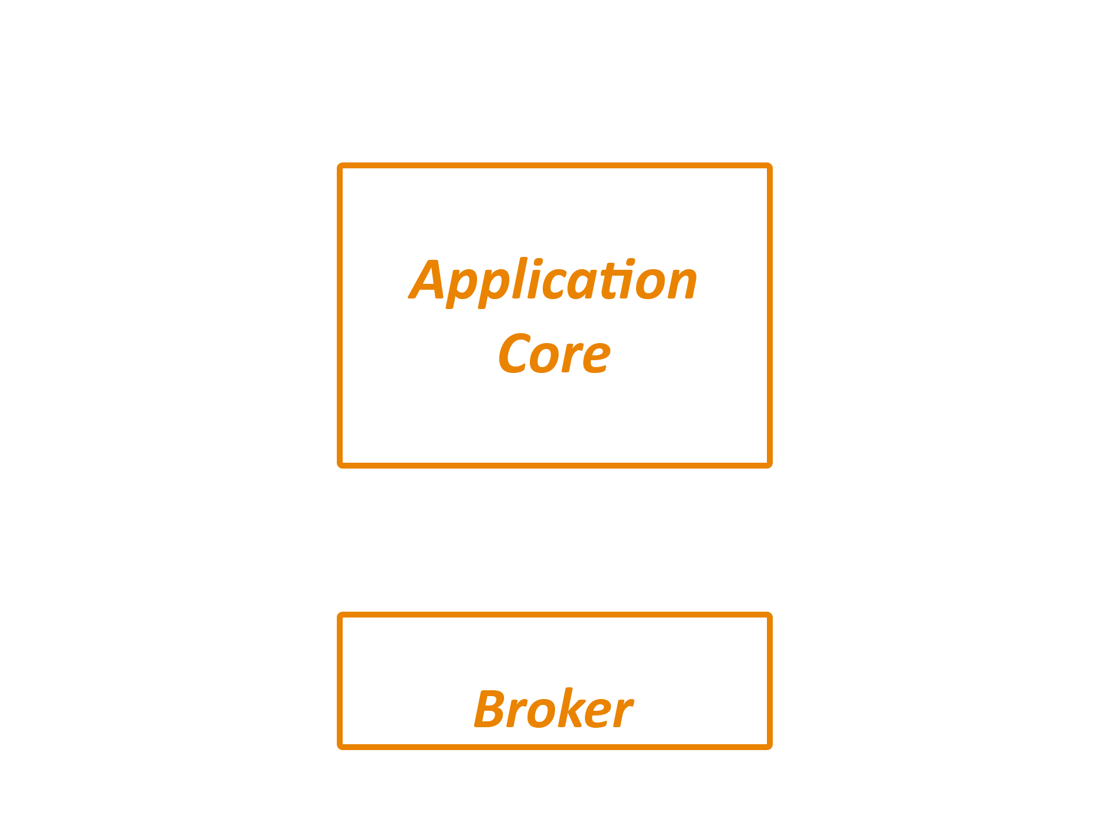
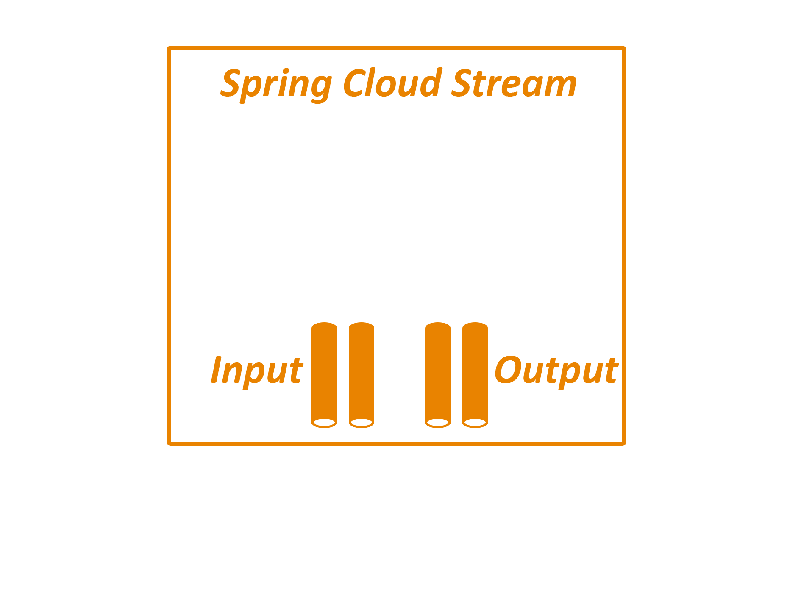

How

Slide 20
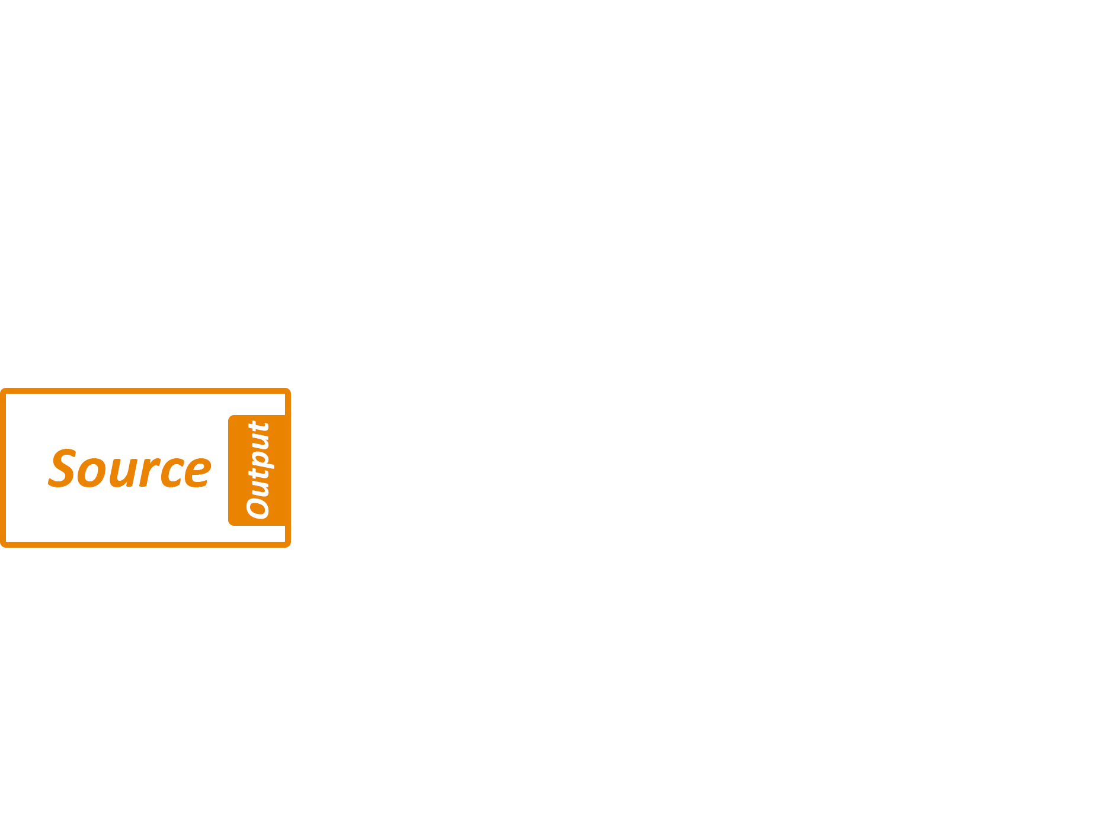
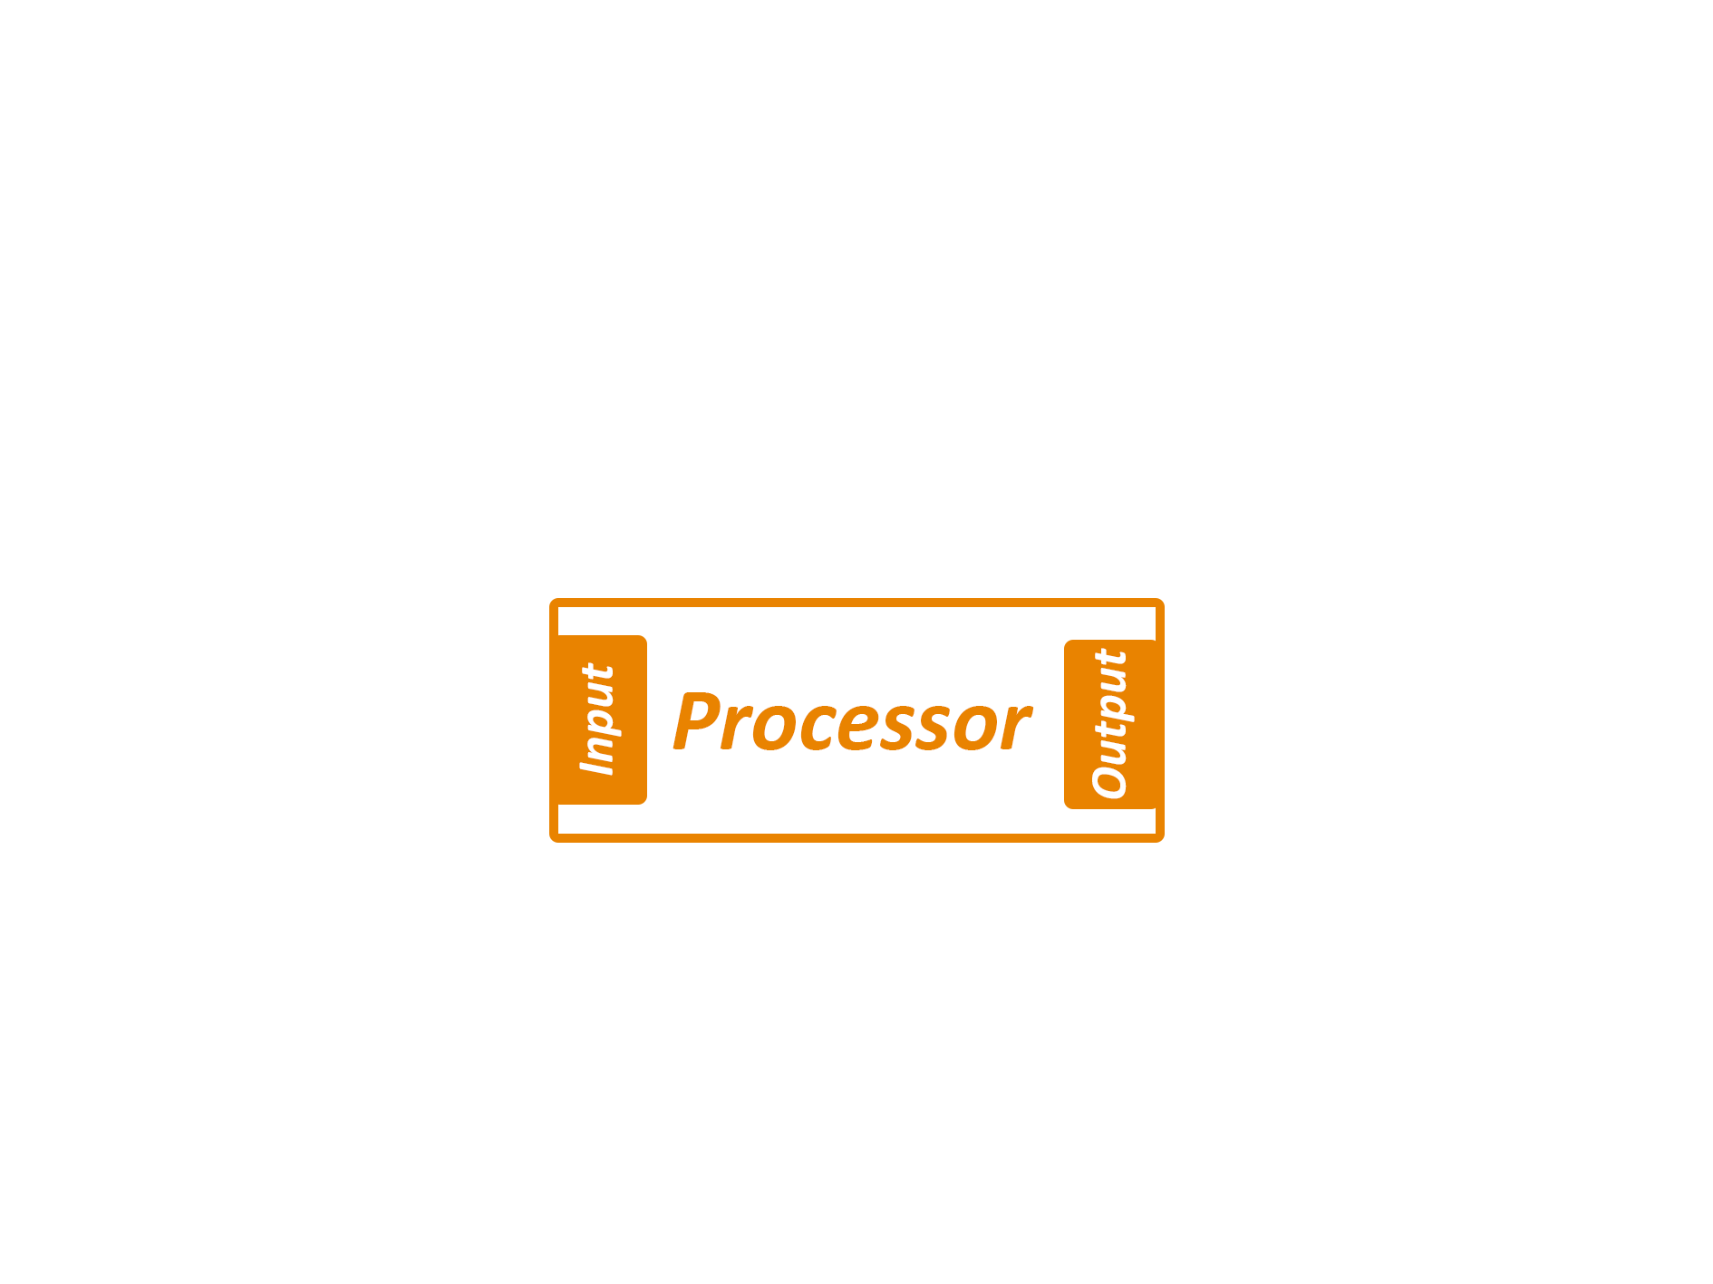
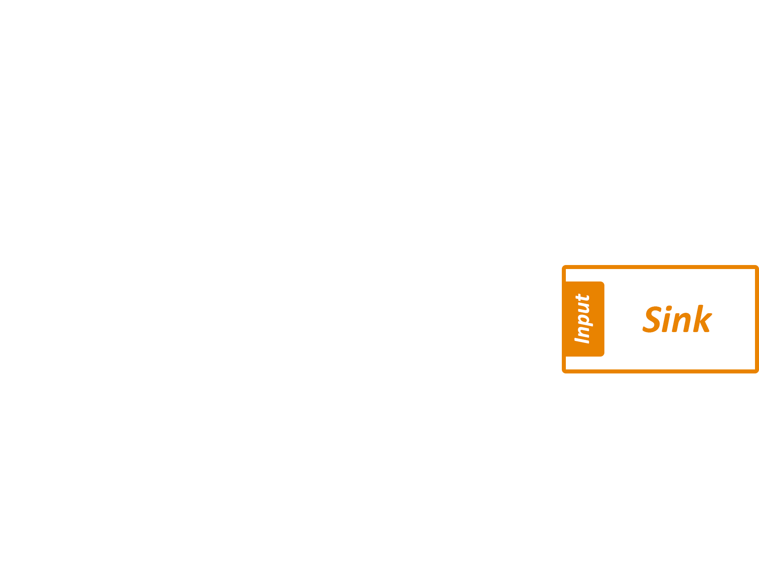
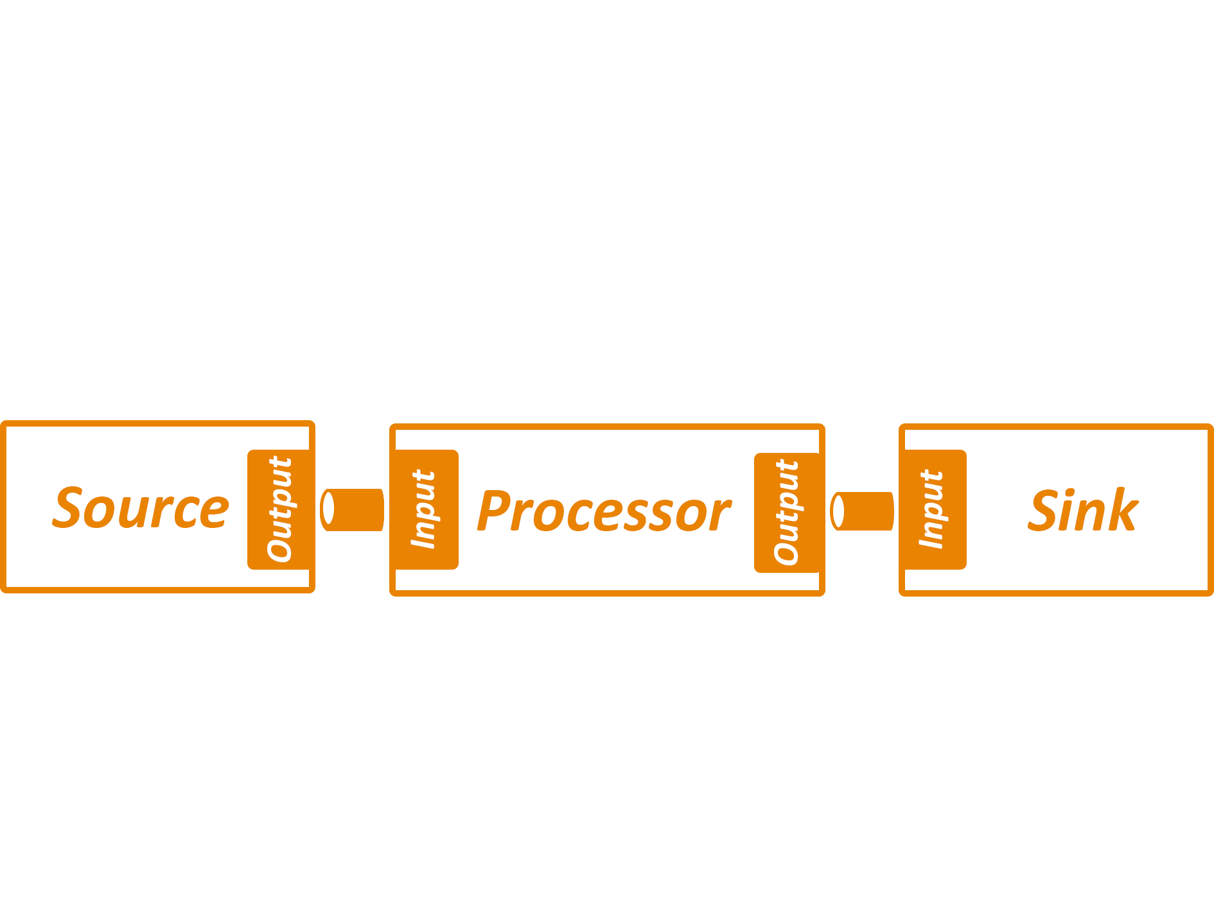
How

Slide 21

Lab 1: Send events to Kafka

Slide 22
Lab 1: Send events to Kafka
Dependencies
spring-cloud-starter-stream-kafka
Added @EnableBinding
Properties:
spring.cloud.stream.bindings.output.destination=traffic-data
Added @Scheduling

Slide 23
Lab 1: Send events to Kafka
Don’t use @Scheduling for use cases like this in production
Bad practice, use batch jobs: eg. Spring Cloud Task or K8s CronJob!

Slide 24
Lab 2: Intake of data from Kafka
@EnableBinding
@StreamListener(Sink.INPUT)
Properties:
spring.cloud.stream.bindings.input.destination=traffic-data

Slide 25
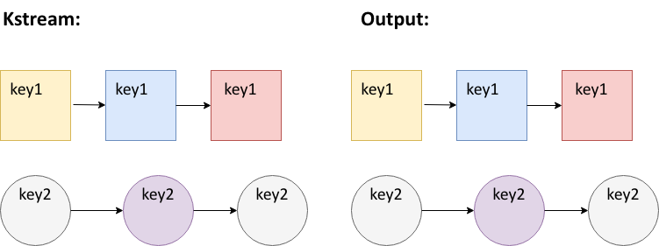
Native streaming: KStream

Slide 26
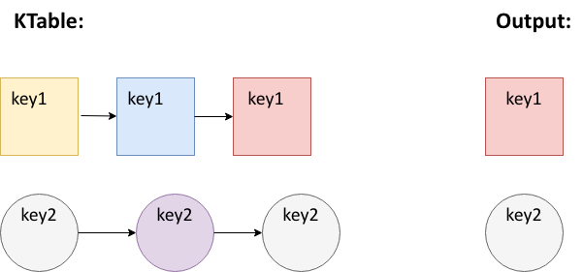
Native streaming: KTable

Slide 27
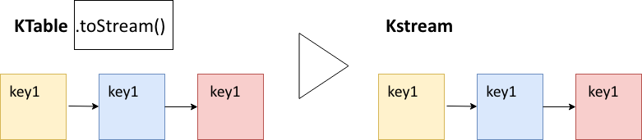
Native streaming operations: toStream

Slide 28
Native streaming operations: Stateless
No need of a state store for these operations

Slide 29
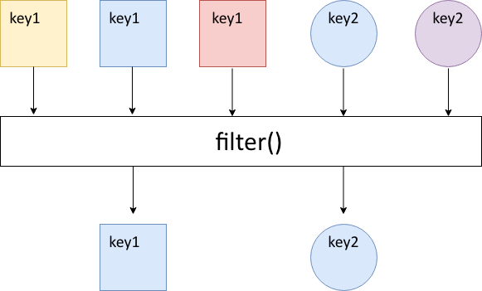
Native streaming operations: filter

Slide 30
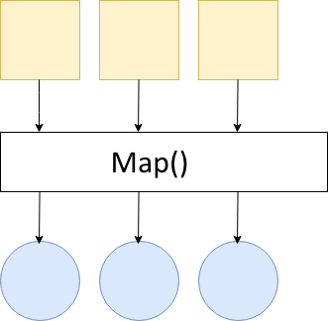
Native streaming operations: map

Slide 31
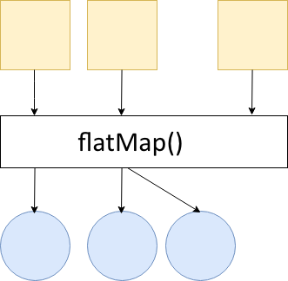
Native streaming operations: flatMap
Notes:
Every record processed can result in 0, 1 or more new records

Slide 32
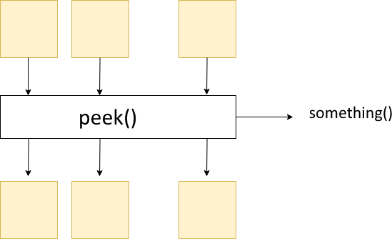
Native streaming operations: peek

Slide 33
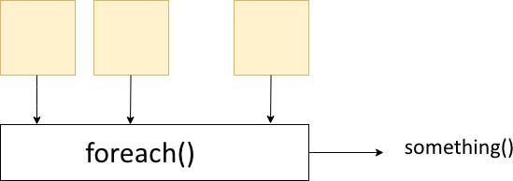
Native streaming operations: forEach

Slide 34
Native streaming operations: Stateless
selectKey
filter
map/mapValues
flatMap/flatMapValues
peek
forEach
groupByKey
toStream

Slide 35
Lab 3: Stateless
Dependencies
spring-cloud-stream-binder-kafka-streams
Added custom interface: KStreamSink
Methods used
.filter
.print
Updated configuration:
spring.cloud.stream.default-binder=kafka
spring.cloud.stream.bindings.native-input.binder=kstream

Slide 36
Native streaming operations: stateful
State store is used
In memory database
RocksDB
Fault-Tolerant: replicated changelog topic in Kafka
Notes:
These data store can also be used by other processors

Slide 37
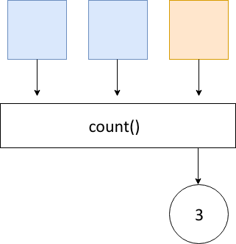
Native streaming operations: count

Slide 38
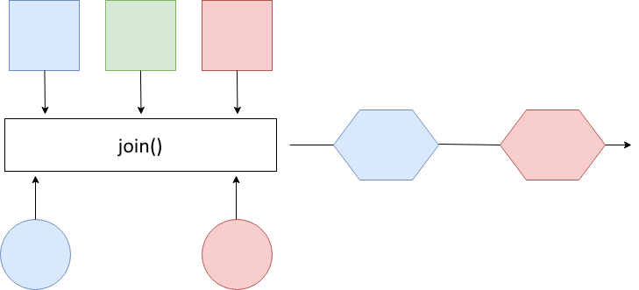
Native streaming operations: joining

Slide 39
Native streaming operations: groupByKey
Groups records in KGroupedStream
Required before aggregation operations
Writes data to new topic (might repartition)

Slide 40
Native streaming operations: aggregations
Transforms groupedKStream to Ktable
Need Initializer: aggValue = 0
Operation: “adder”: aggValue + oldValue

Slide 41
Native streaming operations: stateful
groupByKey (still stateless)
count
aggregations
joining
windowing

Slide 42
Windows
Tumbling
Sliding
Session

Slide 43
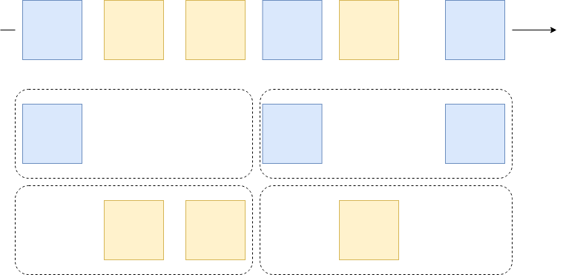
Tumbling

Slide 44
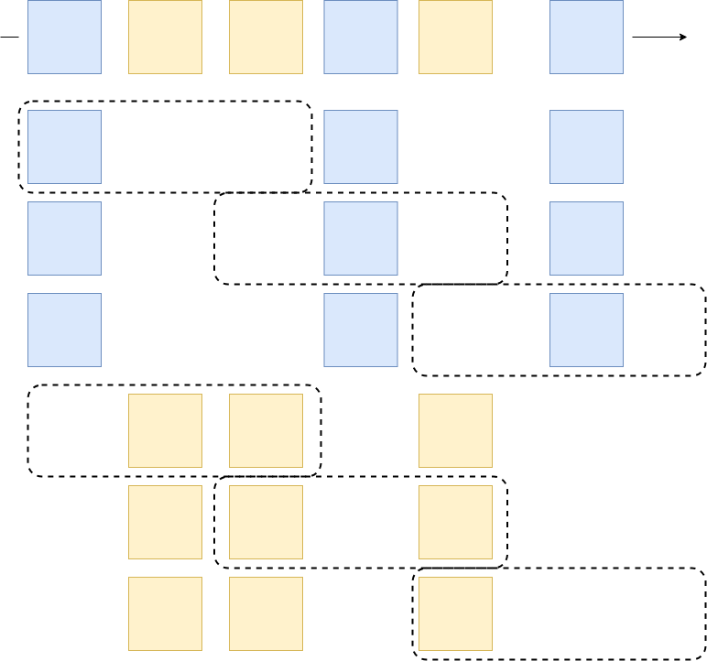
Sliding

Slide 45
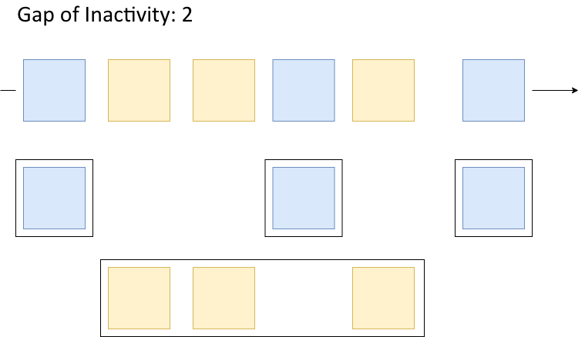
Session windows

Slide 46
Session windows
Limited by an inactivity gap
Be aware: the data you need to process might grow

Slide 47
Lab 4: Windows & Statefull
GroupByKey
Use of SerDe (StringSerde and JsonSerde)

Slide 48
Lab 4: Windows
Methods used
.windowedBy
.aggregate
Use of aggregator class
Materialized with
.mapValues: convert records
.toStream: Convert KTable to KStream

Slide 49
Session windows: Traffic Congestion
Notes:
Interactive whiteboard session to show what you could do with a session window on the current dataset. => merge results into single data point for entire highway section (all lanes and all vehicles) => if average speed < 50 km => traffic jam => send this out to another topic => apply session window with a gap of 5 minutes => aggregate results: vehicle count => resulting output should give you the amount of vehicles involved within a traffic jam
=> Because you also know the length of every given session you should also be able to know how long it lasted.

Slide 50
Session windows: Traffic Congestion
Notes:
Interactive whiteboard session to show what you could do with a session window on the current dataset. => merge results into single data point for entire highway section (all lanes and all vehicles) => if average speed < 50 km => traffic jam => send this out to another topic => apply session window with a gap of 5 minutes => aggregate results: vehicle count => resulting output should give you the amount of vehicles involved within a traffic jam
=> Because you also know the length of every given session you should also be able to know how long it lasted.

Slide 51
Session windows: Traffic Congestion
Merge results of all lanes
If average speed < 50km => slow traffic
To: slow-traffic-topic
@Input slow-traffic-topic => session window with gap of 5 minutes
Aggregate results: vehicle count
To: vehicles-involved-in-traffic-jam
Because the session window also has a start and end time
=> length of the traffic jam
Notes:
Interactive whiteboard session to show what you could do with a session window on the current dataset. => merge results into single data point for entire highway section (all lanes and all vehicles) => if average speed < 50 km => traffic jam => send this out to another topic => apply session window with a gap of 5 minutes => aggregate results: vehicle count => resulting output should give you the amount of vehicles involved within a traffic jam
=> Because you also know the length of every given session you should also be able to know how long it lasted.

Slide 52
Thank you for attending!

